Slide 1
Foxes Lifting Limits

Slide 2
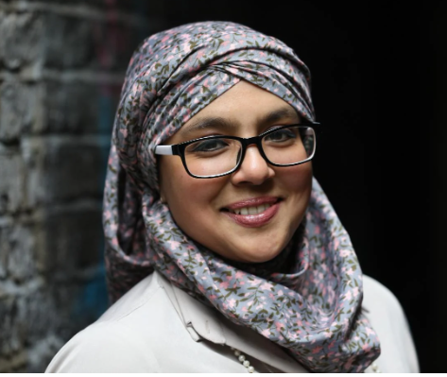
Last term, our English work focussed on ‘The Boy at the Back of the Class.’ We were inspired by the visit of Onjali Rauf – and now lots of us would love be authors one day. We loved the story, which was narrated from the point of view of a courageous and determined girl called Alexa.

Slide 3
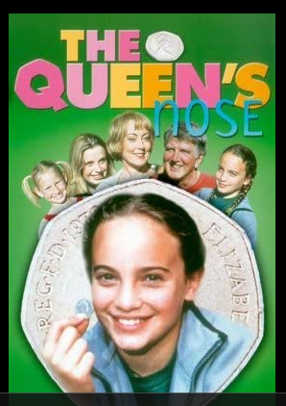
In the Autumn Term, our work in English was based on ‘The Queen’s Nose’ by Dick King-Smith. The main character and hero of the story is Harmony Parker, who discovers that the 50p piece given to her by her uncle can grant her magical wishes.

Slide 4
‘Meet 52 icons of colour from the past and present in this collection of stories about change-makers to encourage, inspire and empower children young and old. Written in the spirit of Nina Simone’s song “To Be Young, Gifted, and Black,” this vibrant book is a perfect introduction figureheads, leaders and pioneers,’ (The New York Times).
This term we have been uplifted by the stories of inspirational black women, including Rosa Parks, Josephine Baker, Harriet Tubman and Mary Seacole.

Slide 5
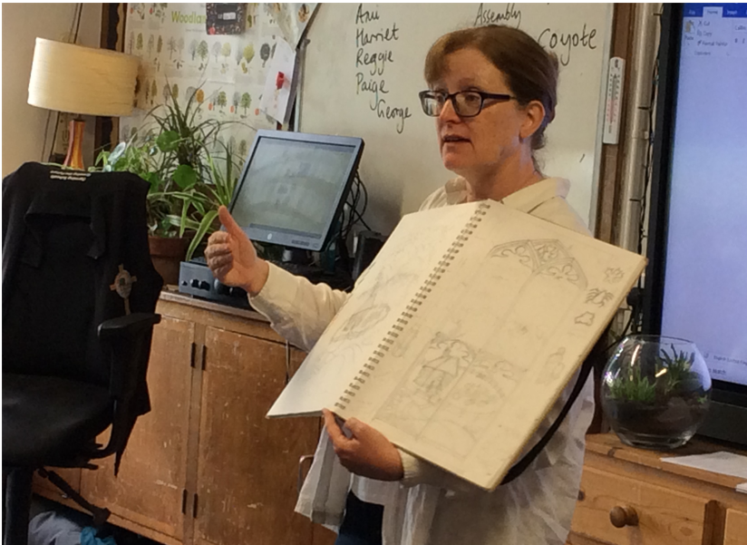
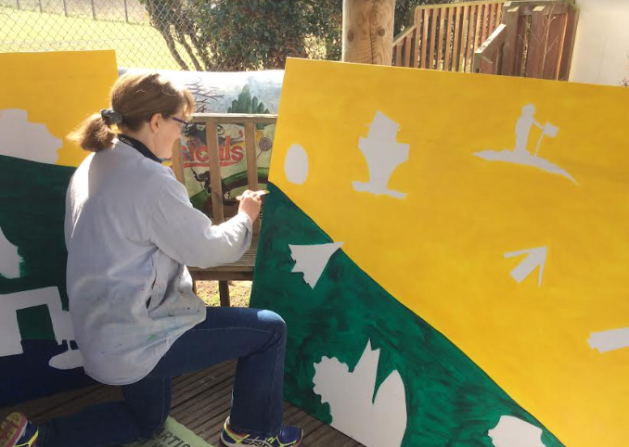
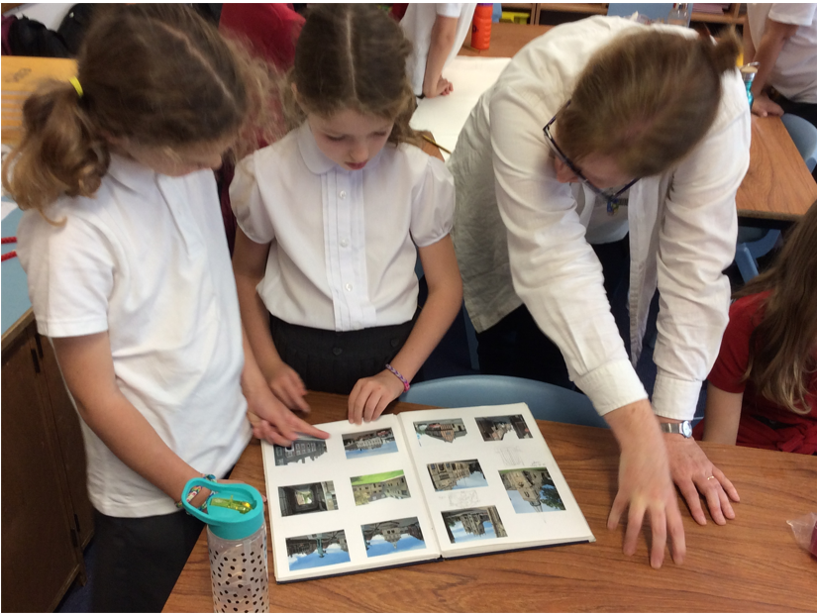
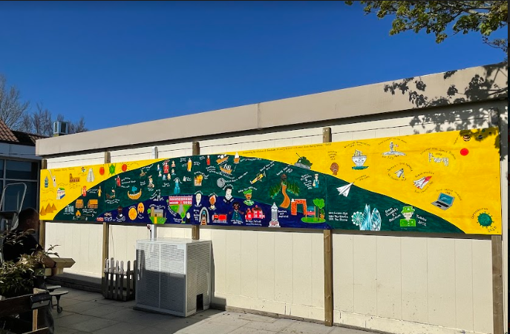
Local artist, Nicola Marray-Woods wowed with her amazing talents as she shared her skills and inspired us to make amazing sketches of our own which she then painted on our incredible timeline.

Slide 6
The lives and achievements of women in history are promoted and celebrated on our timeline, with Boudicca, Queen Victoria, Mary Seacole, Elizabeth I and Elizabeth II all featuring prominently.

Slide 7
The lives and achievements of women are studied and celebrated in our history curriculum. The children carry out research to answer the following key enquiry questions:
EYFS: Who was Mae Jemeson and what did she achieve?
Year 1 and 2: Who is Mary Anning and what did she achieve?
Year 3: Who resisted the Roman invasion (Boudicca)
Year 5: Compare and contrast and reflect on the experience of women in Athens and Sparta.
Year 6: Who was Norma Best and what did she achieve?
Year 6: Who is Queen Elizabeth I and what is her legacy? Who is Queen Victoria and what is her legacy?

