Slide 2
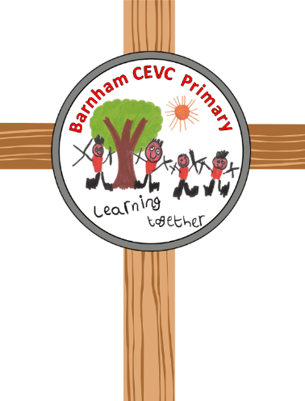
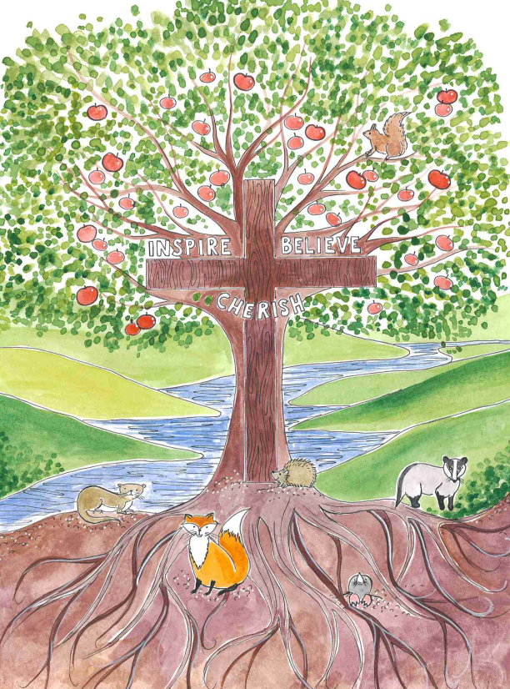
A curriculum full of vision

Slide 3
Our vision is for everyone in our school to
Inspire, Cherish and Believe
in each person that they might flourish and fulfil their potential.
We live this out in school like this verse from the Gospel of John 15:5:
Jesus said ‘I am the vine; you are the branches.
If you abide in me and I in you, you will bear much fruit.’

Slide 4
The vines join together to provide shade and shelter to those who need it. We are all connected and share a belongingness to each other.
Jesus is the trunk, the heart of our school, with the deepest roots imaginable. Even in a drought, the leaves of the vine are green and the branches grow vigorously, adventurously and eager for life – just like we do!
We believe passionately that our children need to be informed about all Christian values in order to be well-rounded children that make a difference in the world that we live. We want them to be like strong trees that is referred to in the bible in the book of Jeremiah Chapter 17: 7-8:
“But blessed is the one who trusts in the Lord, whose confidence is in him. They will be like a tree planted by the water that sends out its roots by the stream. It does not fear when heat comes; its leaves are always green. It has no worries in a year of drought and never fails to bear fruit.”
Together we produce the most amazing fruits, whether it’s the work in our classrooms or our time in the fields or in our own person.

Slide 5
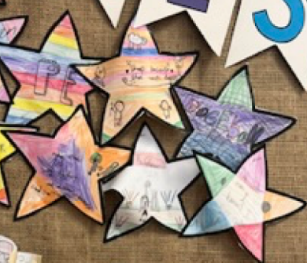
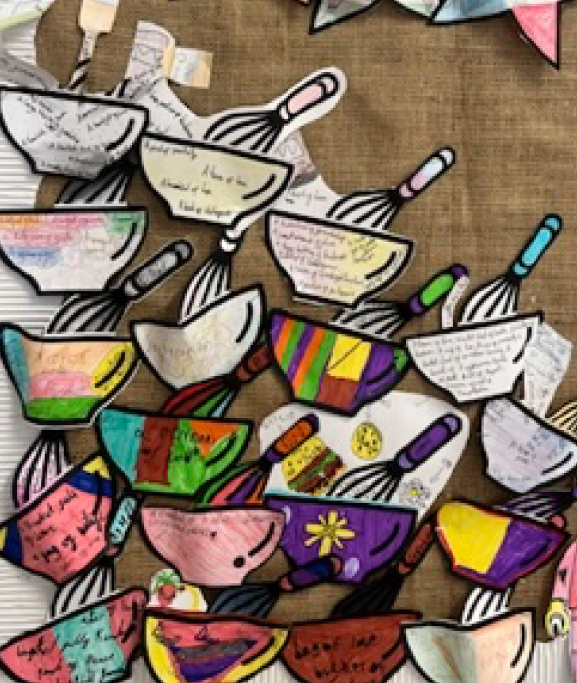
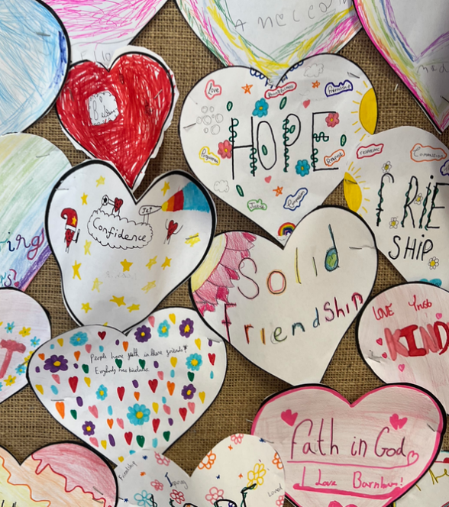
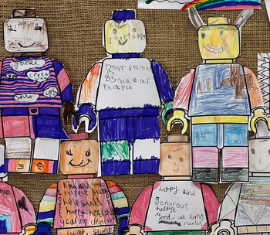
Does our vision still fit our school?
Vision and Values Week
July 2023

Slide 6
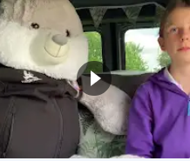
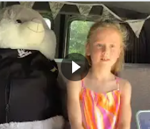
Does our vision still fit our school?
Pupil views via Bunny Cam!

Slide 7
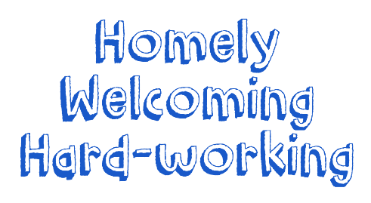
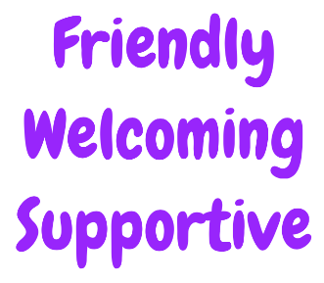
Vision and Values Week
Words children came up with to describe our school during circle time

Slide 8
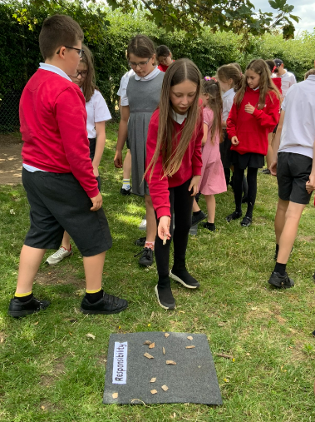
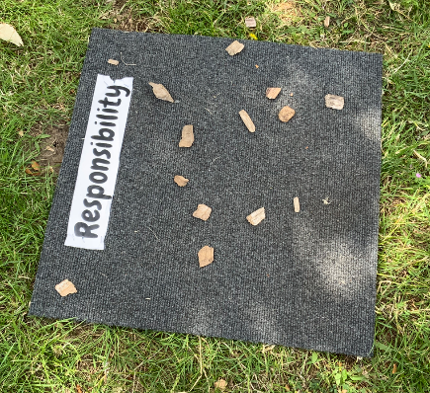
Vision and Values Week
Voting for Values… we voted with flowers to celebrate values that we are good at and used bark to mark the ones we need to practice or learn about a bit more.
We felt we were really good at:
Friendship – Courage – Thankfulness
But felt we could get better at or learn more about:
Truth – Responsibility – Perseverance and Resilience
Because:
“Sometimes people lie and don’t tell the truth.”
“We don’t always take responsibility for looking after out school environment.”
“We want to give up too easily sometimes.”

Slide 9
Vision and Values Week
What did the adults who work in school say?
“I feel ‘Inspire, Cherish, Believe absolutely reflects our school.”
“I love this school family that I became a part of.”
”It’s a wonderful school.”
“I feel inspired every day by both children and adults at school.”
Some of the words that adults chose to describe Barnham:
safe, ambitious, pride, nurturing, together, inclusive, encourage

Slide 10
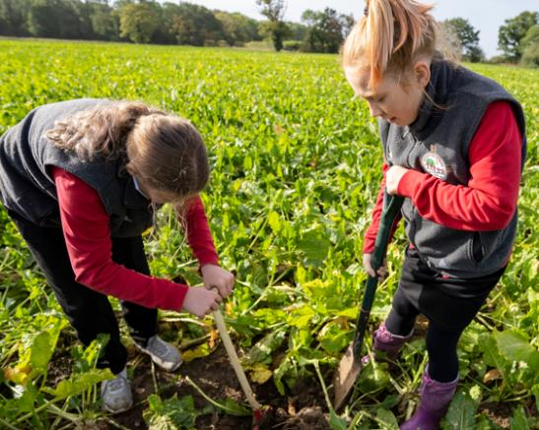
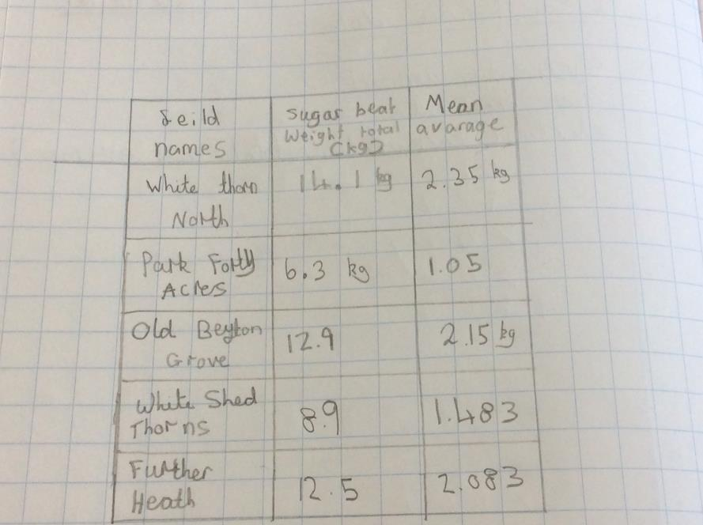
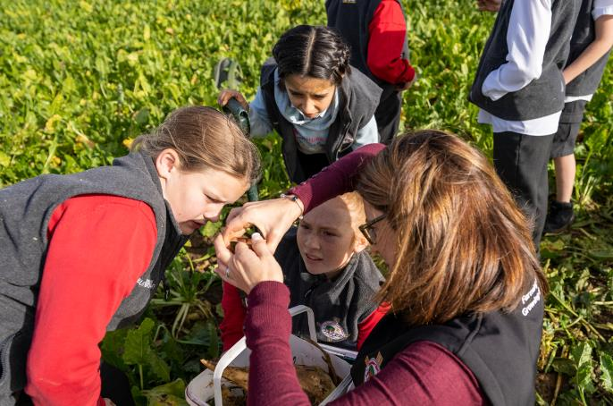
A curriculum full of vision!
Which sugarbeet field should the farmer harvest first?
Hands on real life learning opportunities

Slide 11
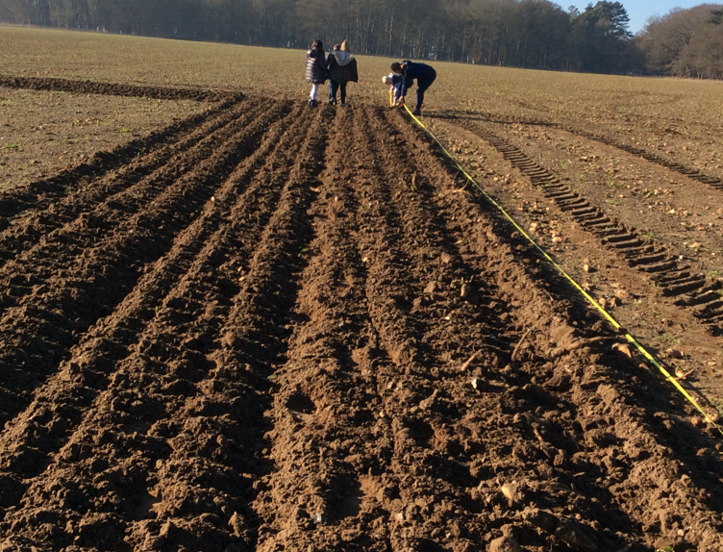
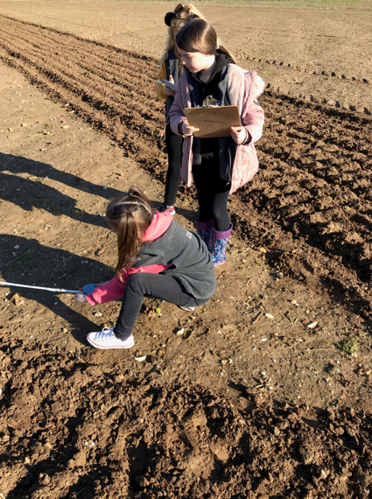
A curriculum full of vision!
Bringing the curriculum to life by large scale investigating
Year 4 – Discovering perimeter

