Slide 1
What groups are plants classified in?
BBC video classifying plants
https://www.youtube.com/watch?v=cgVlrtGnG6s

Slide 2
Vocabulary
Classify
Categorise
Spores
Reproduce
Photosynthesis
Video on how plants reproduce
https://vimeo.com/218127170

Slide 3
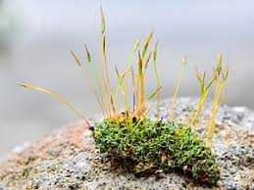
Mosses
Mosses are flowerless and seedless plants.
They reproduce by spores. (A spore is a cell that certain fungi, plants (moss, ferns), and bacteria produce.)
The most commonly found group is the green mosses that cover rotting logs, grow on the bark of trees, and grow in the spray of waterfalls, along streams and in bogs.
Even though mosses often thrive in wet habitats, some mosses and some liverworts can survive in quite dry environments such as sandy soils and exposed rock outcrops.

Slide 4
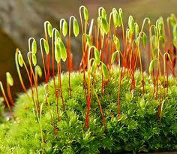
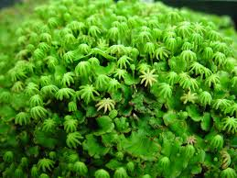
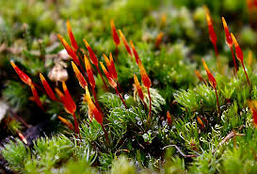
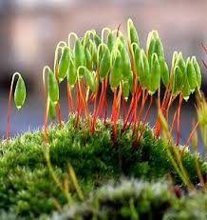
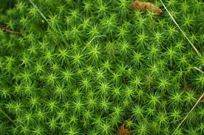
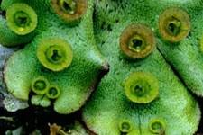

Slide 5
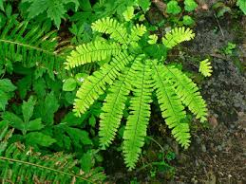
Ferns
Ferns are a group of non-flowering plants that reproduce by releasing spores rather than seeds
They include the true ferns and other graceful, primarily forest-dwelling plants.
There are about eleven thousand different species of ferns making them the most diverse land plants after the flowering plants (angiosperms).

Slide 6
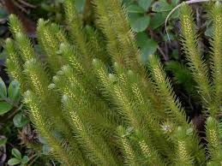
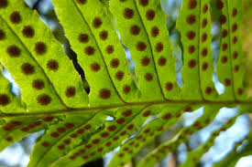
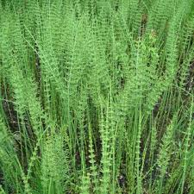
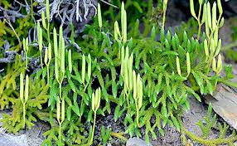
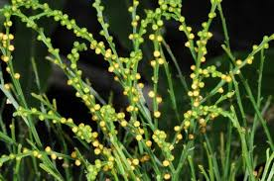

Slide 7
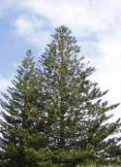
Conifers
Conifers grow in all climates and on all continents except Antarctica.
They all bear their seeds within a cone or a structure resembling a berry.
Most conifers are trees.
Conifers appeared in the fossil record about 290 million years ago and have been an ecologically important, widespread group ever since then.

Slide 8
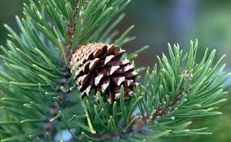
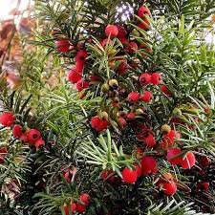
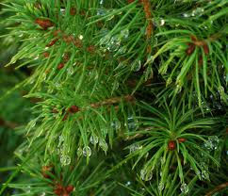
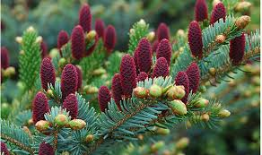
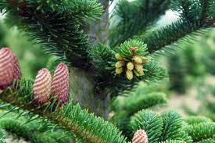
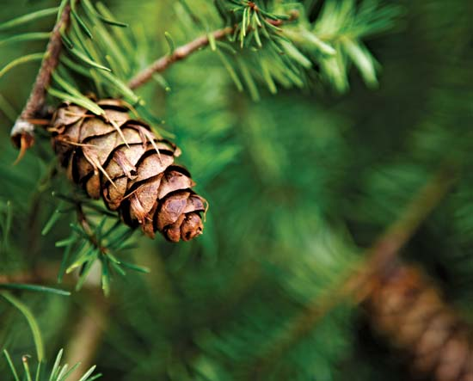

Slide 9
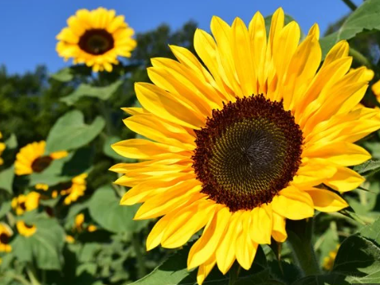
Flowering plants
The angiosperms are plants who produce fruits and flowers.
Seeds can easily be seen by slicing into a tomato, for example.

Slide 10
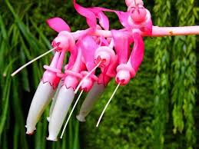
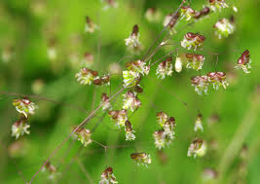
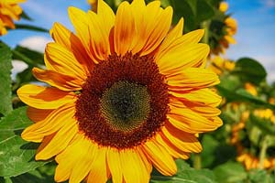
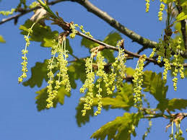
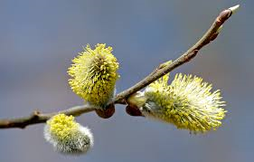
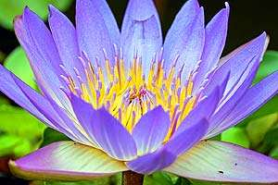

Slide 11
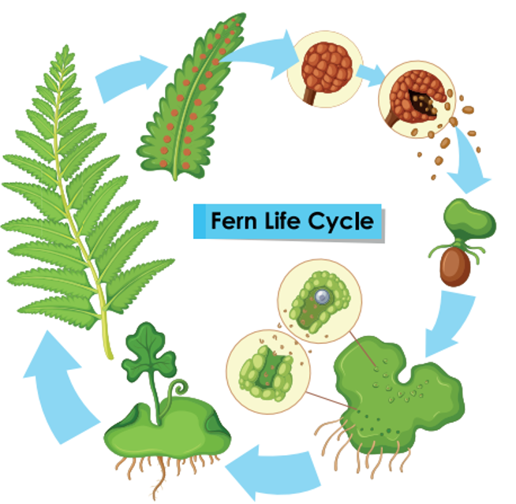

Slide 12
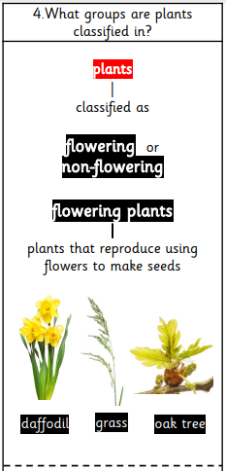
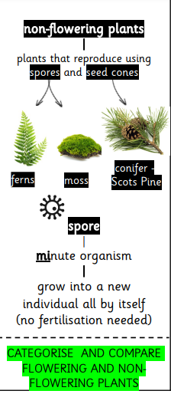

Slide 13
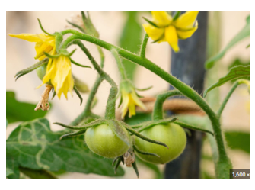
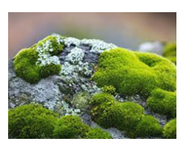
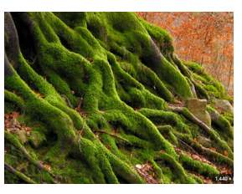
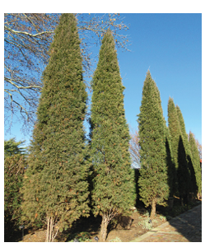
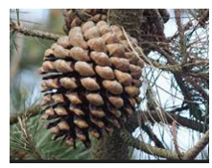
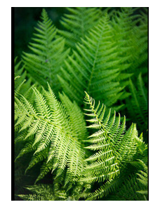
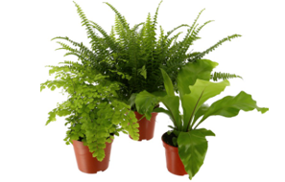
Flowering
Non-flowering
Conifers
Mosses
Ferns

Slide 14
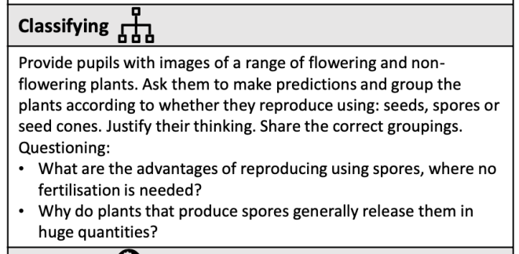
Explore the school grounds
to find examples below:
Activity

Slide 15
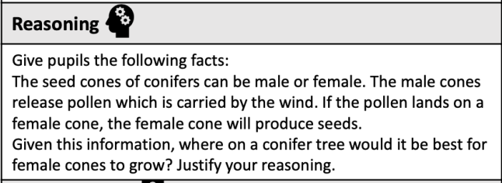

Slide 16
NS

