Slide 1
LOtC Local Visits 2023-24 (Within walking distance of school)

Slide 2
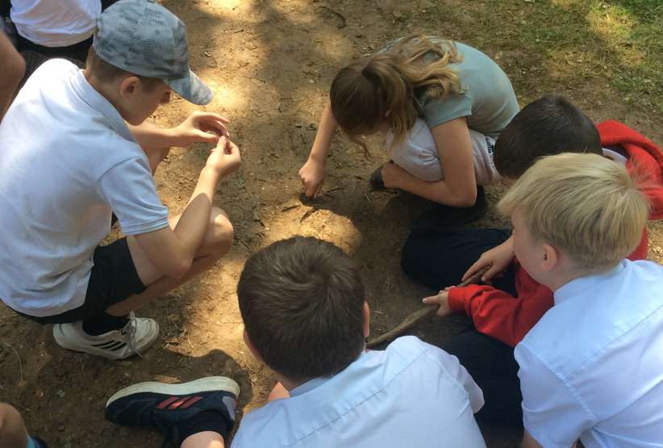
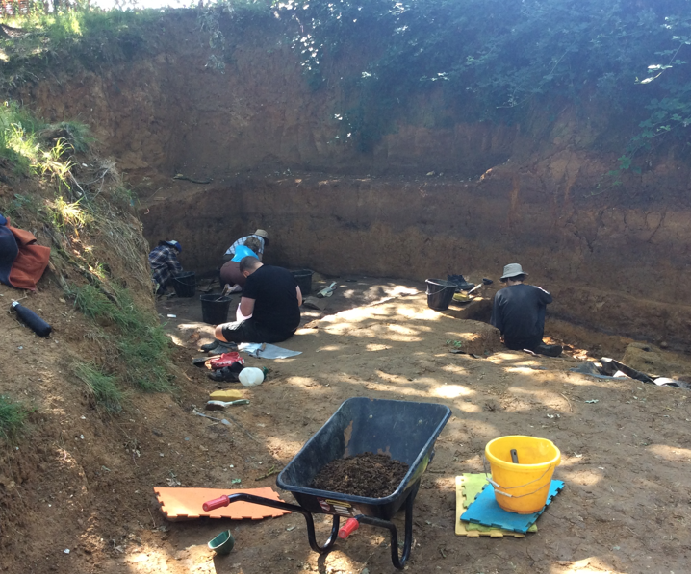
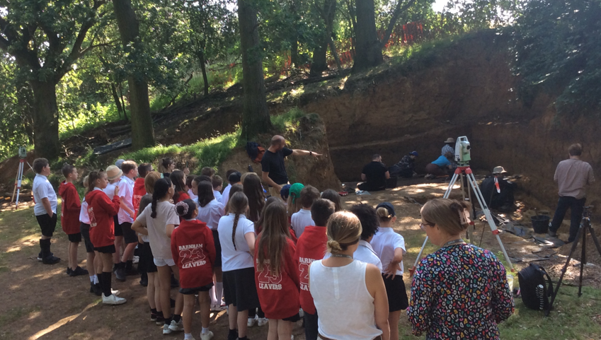
Visit to an archaeological dig in Barnham with the British Museum

Slide 3
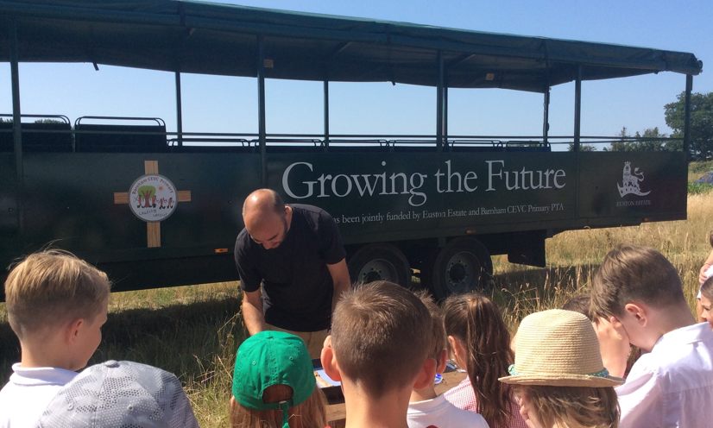
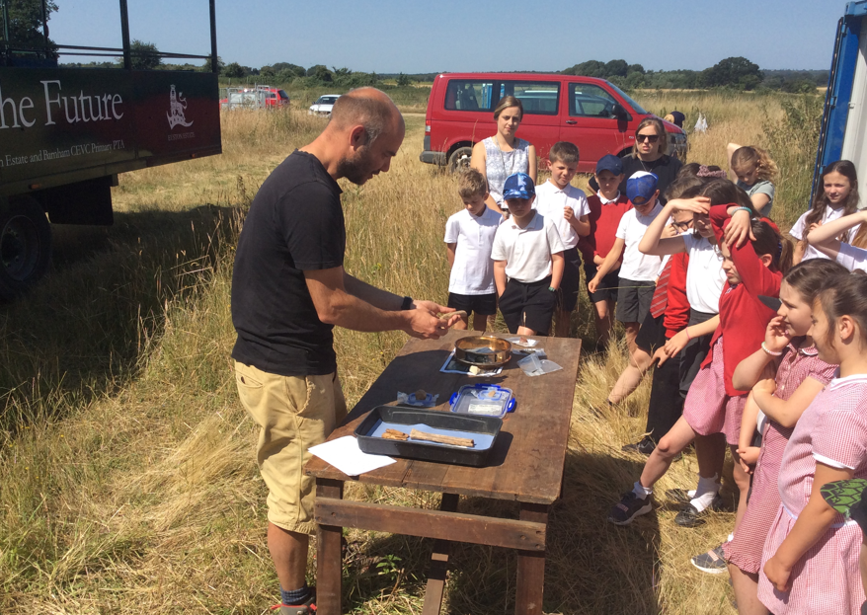
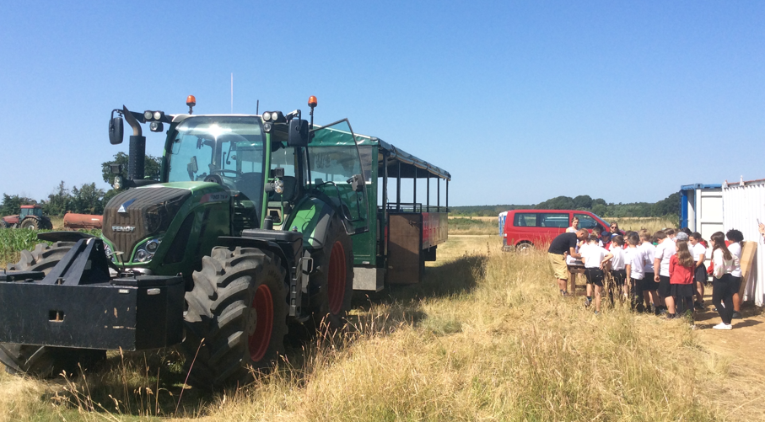
Archaeological dig visit with Rob-British Museum Lead Archaeologist - showing us a lion’s claw found at the Barnham site (the trailer is sponsored by the Euston Estate and our PTA)

Slide 4
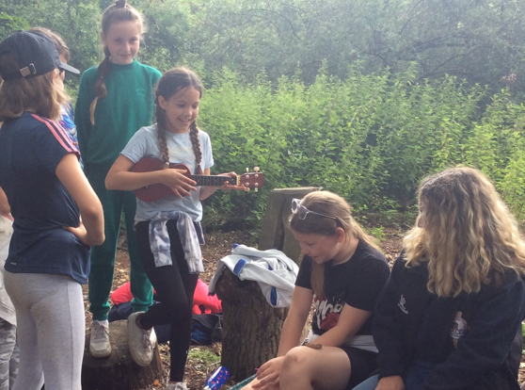
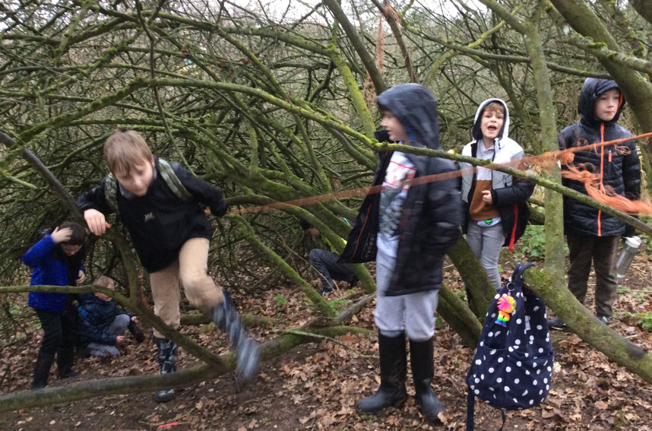
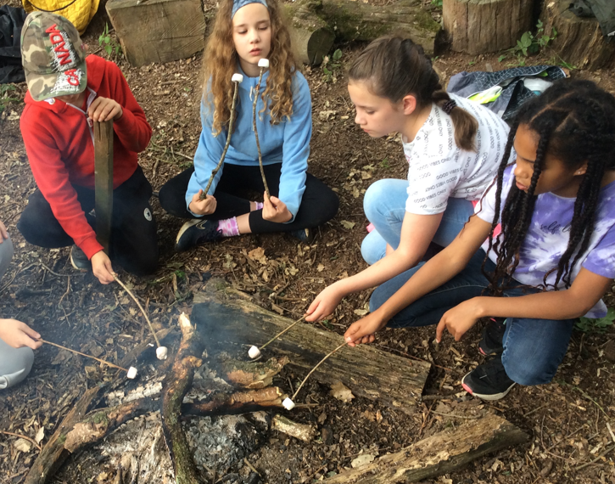
Year 4 and 5 Forest School Adventures

Slide 5
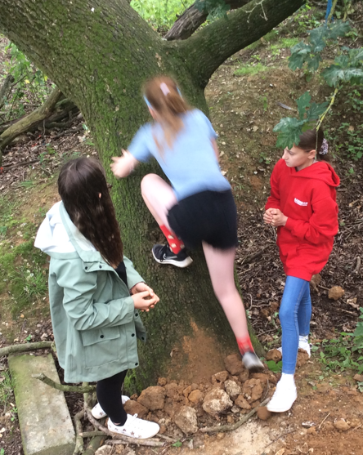
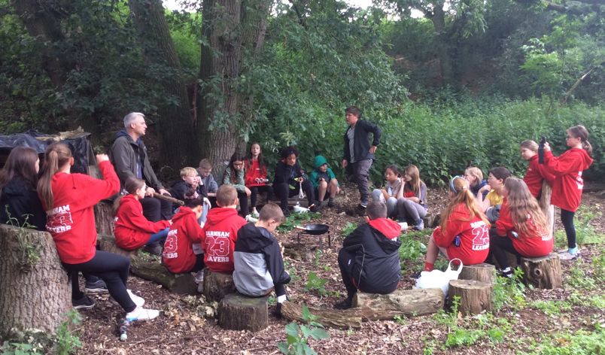
Year 6 Forest School

