Slide 1
EARTH AND SPACE!
YEAR 5 SCIENCE

Slide 2
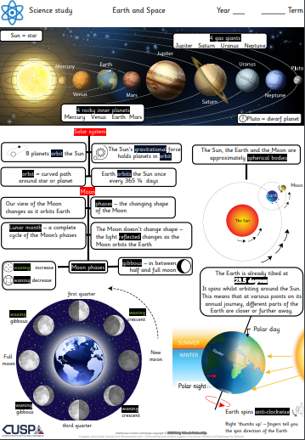
Why does the rotation of Earth result in night and day?
Thursday 11th May 2023

Slide 3
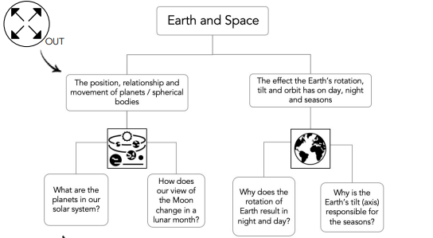

Slide 4
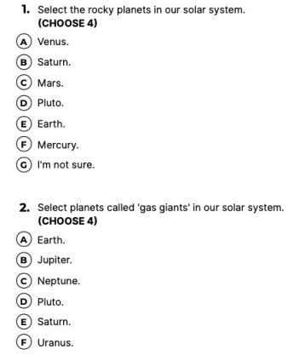
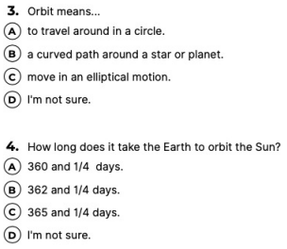
Recap Quiz:

Slide 5
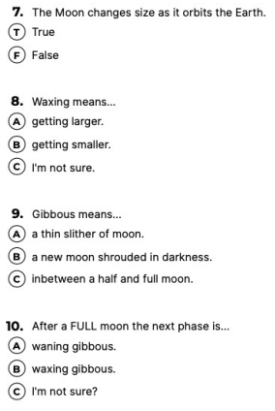
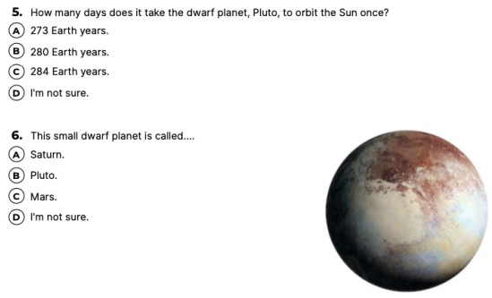
Recap Quiz:

Slide 6
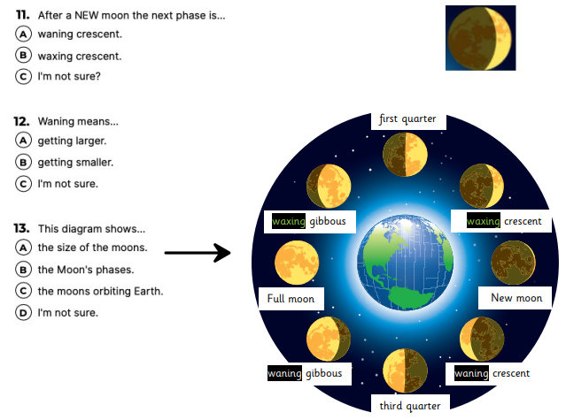
Recap Quiz:

Slide 7
Answer these questions…
https://www.yout-ube.com/watch?v=hPsKsUbW1WY

Slide 9
Describe and explain what the effect would be if:
The Earth were to spin faster on its axis.
The Earth were to spin more slowly on its axis.
The Earth were to stop spinning. (Challenge)

Slide 10
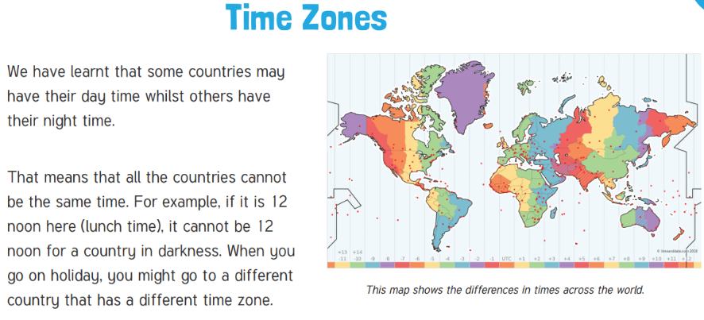

Slide 11
TASK:
We are going to be doing an experiment across the day to see how the position of the sun and Earth change throughout the day.
This links with our Maya topic! We are going to be creating sundials like the Maya used during their time to tell the time.
With your partner you need to help one another with your playdough, pencil and paper plate and get ready to take them outside. Write your name lightly in pencil on your plate.

Slide 12
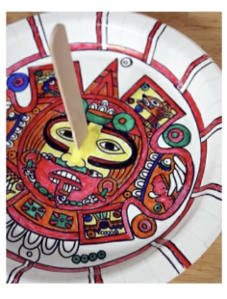
TASK:
You are going to draw a small line on your plate to show where the pencil’s shadow is, at:
10am,
11am,
12pm,
1pm,
2pm, 3pm

Slide 13
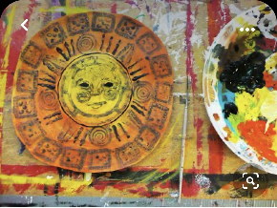
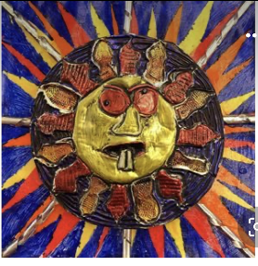
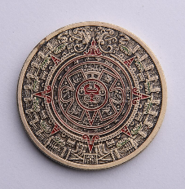
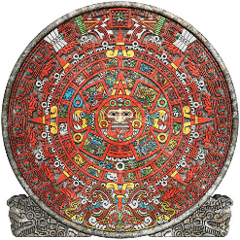
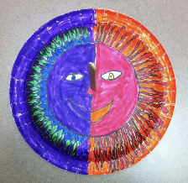
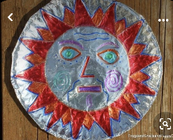
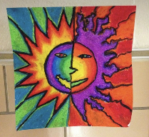

Slide 14
TASK:
Create a graph to plot the length of the pencil shadow at each hour.
X axis = Time of day
Y axis = Length of shadow

Slide 15
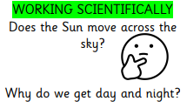
Does the sun move across the sky?
Why do we get day and night?
Moon | rotation | Ancient Maya
Earth | axis | Sun dials
Sun | Summer | clocks
day | Winter | shadows
night | Length of days
lit up | 24 hours
darkness | time zones
50 tps 100 tps 150 tps

