Slide 1
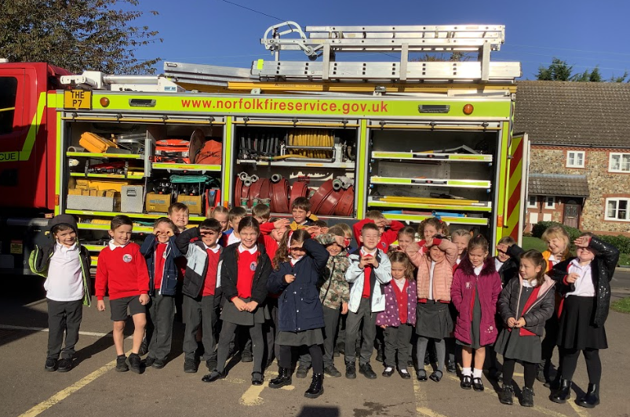
Wednesday 12th October 2022

Slide 2
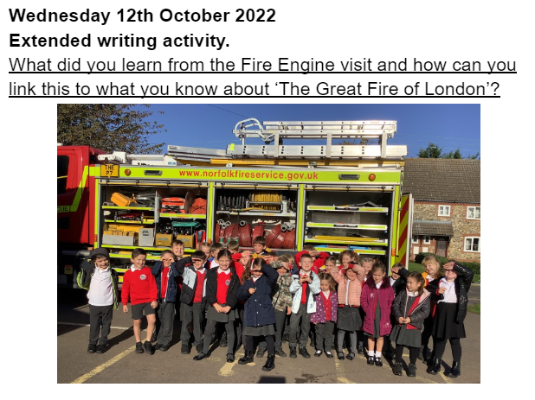

Slide 3
