Slide 1
LOtC Supporting Evidence: Policies, Risk Assessments and Outdoor Learning Request Forms

Slide 2
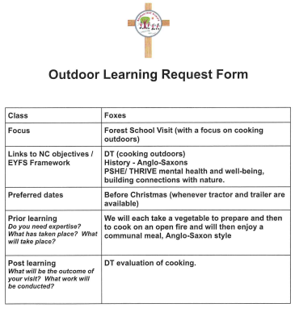
Examples of ‘Outdoor Learning Request Forms’ completed by teachers across the school showing links to prior and future learning in addition to National Curriculum links.
The forms show that when expertise or enhancement is needed staff can request it. These are in addition to our planned knowledge engagement trips which are embedded in the curriculum - especially Science and Geography

Slide 3
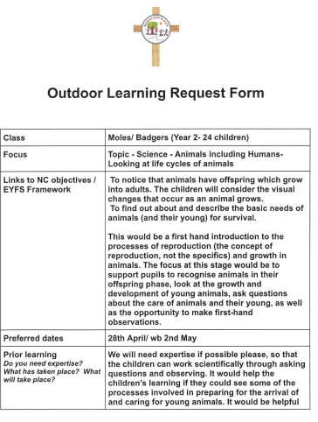

Slide 4
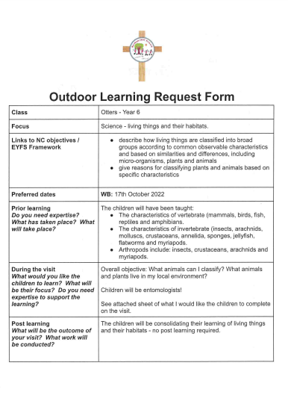
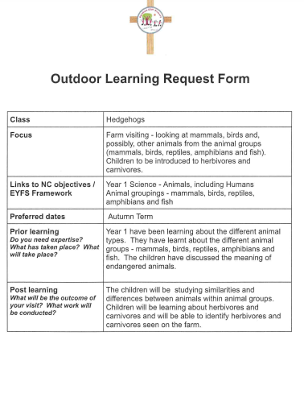

Slide 5
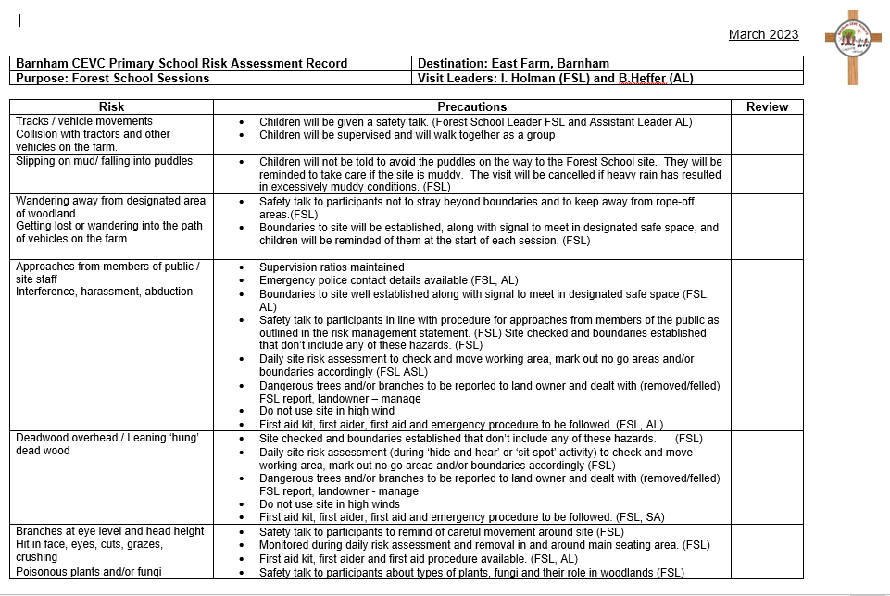
Forest School Risk Assessment

Slide 6
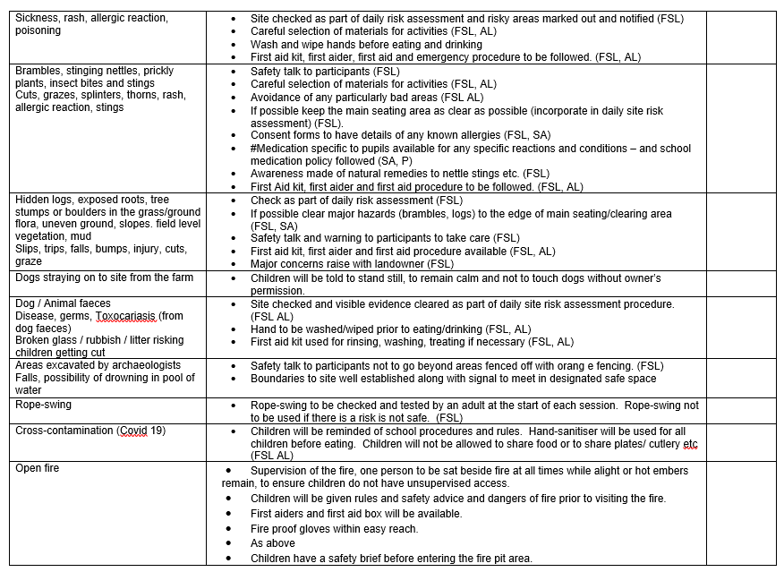

Slide 7
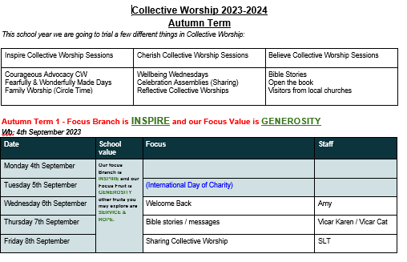
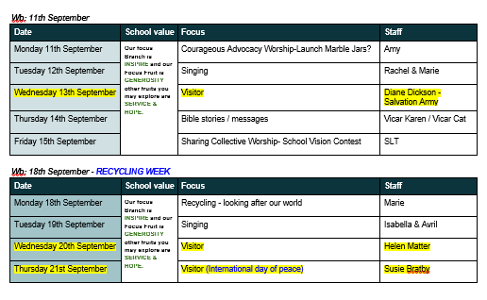
Collective Worship Rota (Showing Visitors Highlighted in Yellow)

